Slide 1
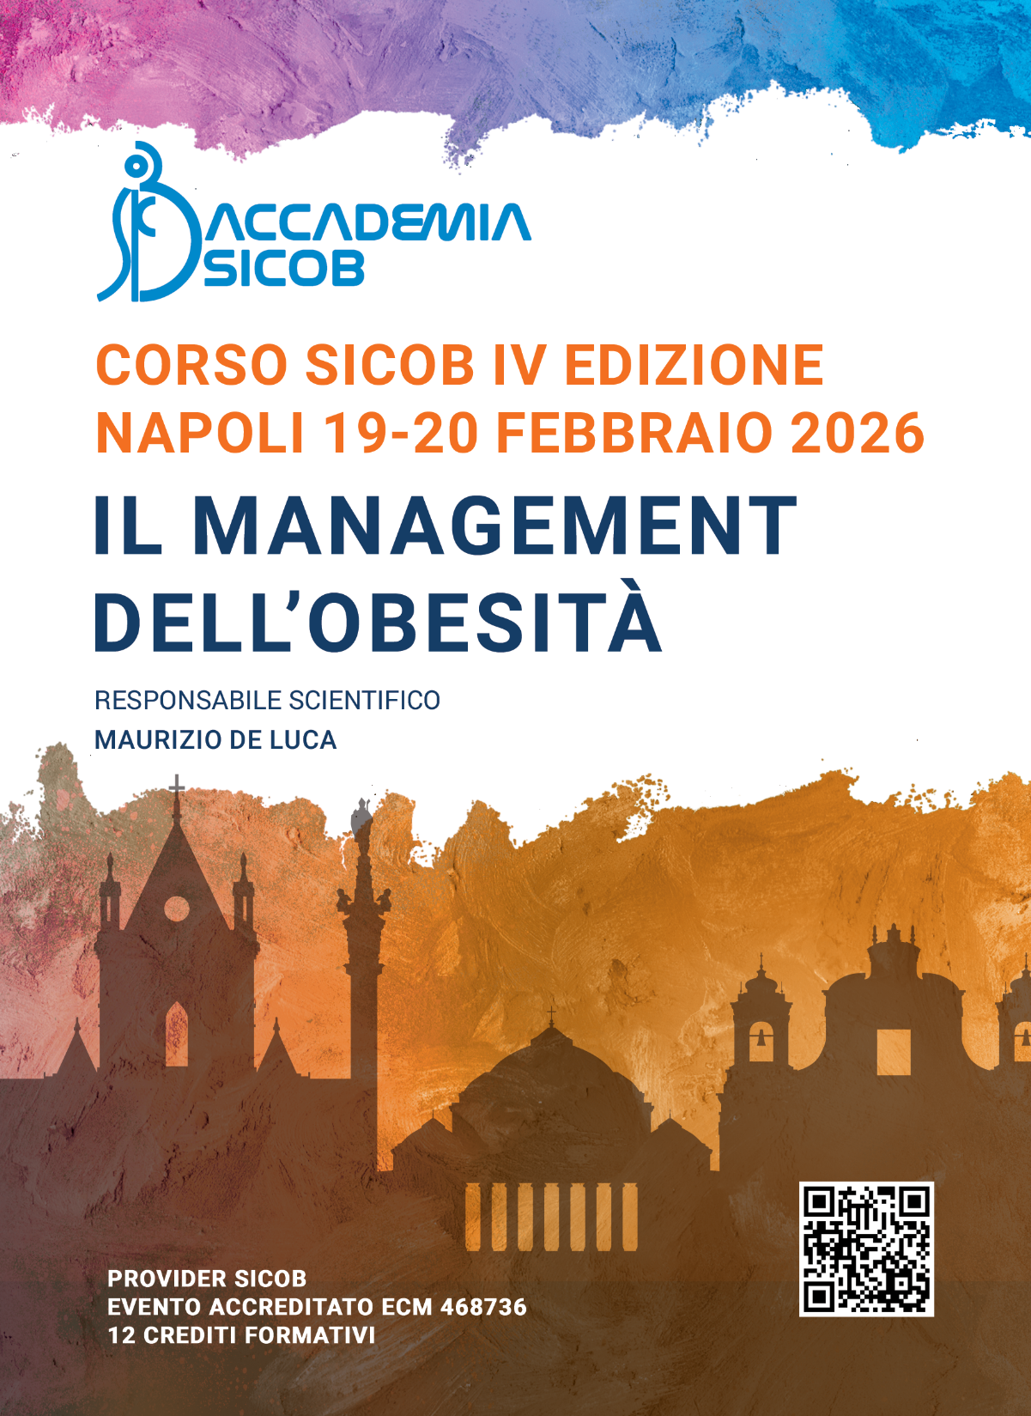
AI, trattamento farmacologico e
Chirurgia Bariatrica Metabolica
Mirto Foletto, MD
Azienda Ospedale Universita’- Padova

Slide 2
Disclosures: I am not an AI scientist,
but confident AI will be filling the gaps in our daily clinical practice

Slide 3
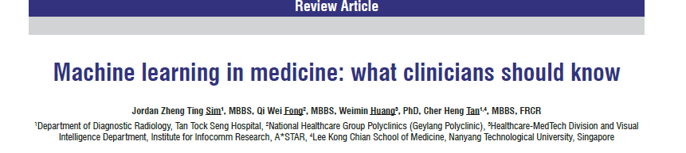

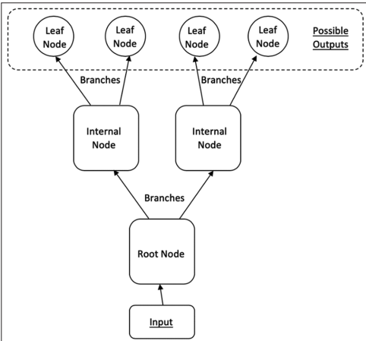
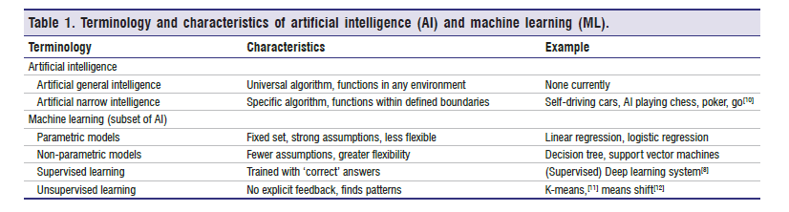
Ting Sim JZ, Fong QW, Huang W, Tan CH. Machine learning in medicine: what clinicians should know. Singapore Med J. 2023 Feb;64(2):91-97.

Slide 4
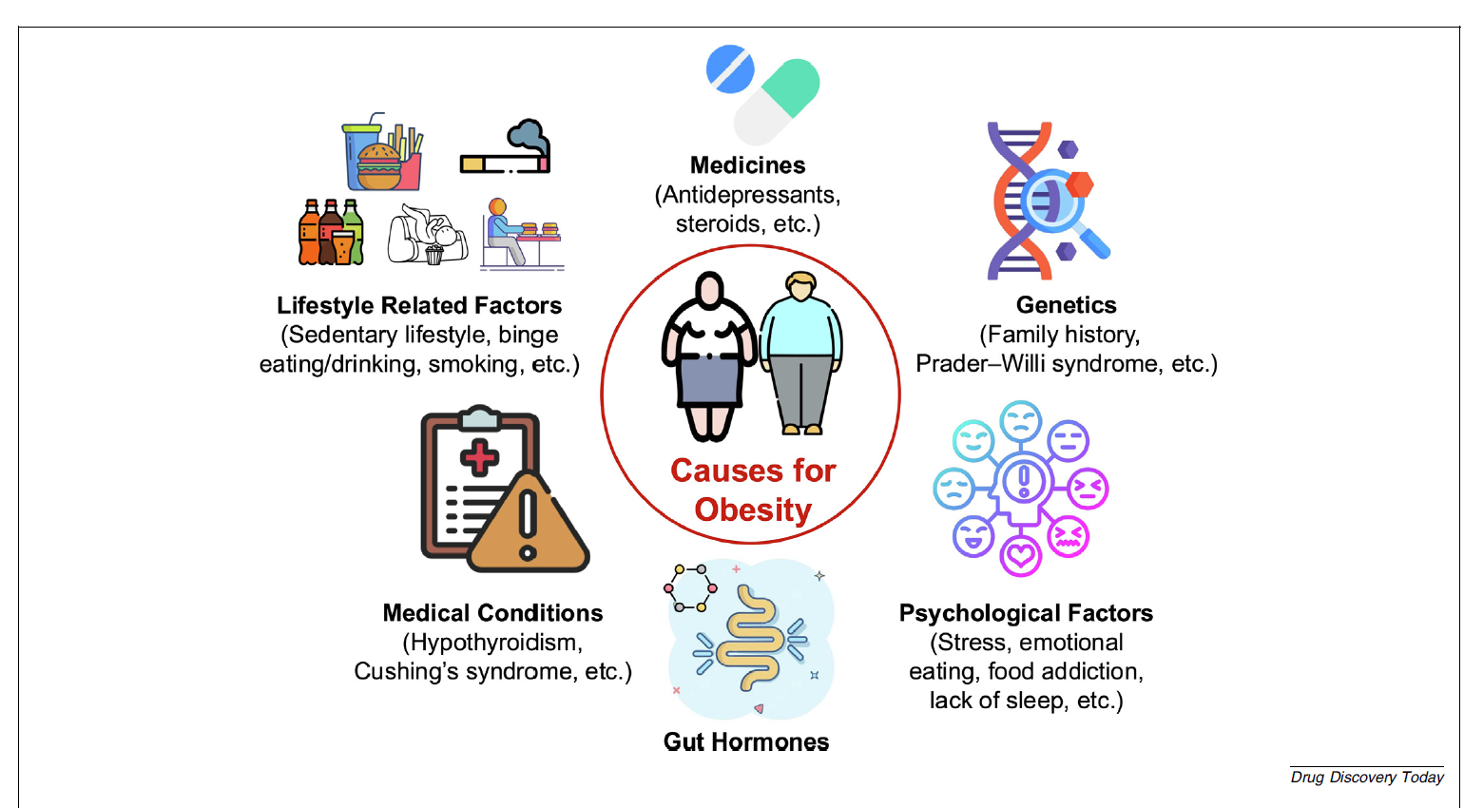
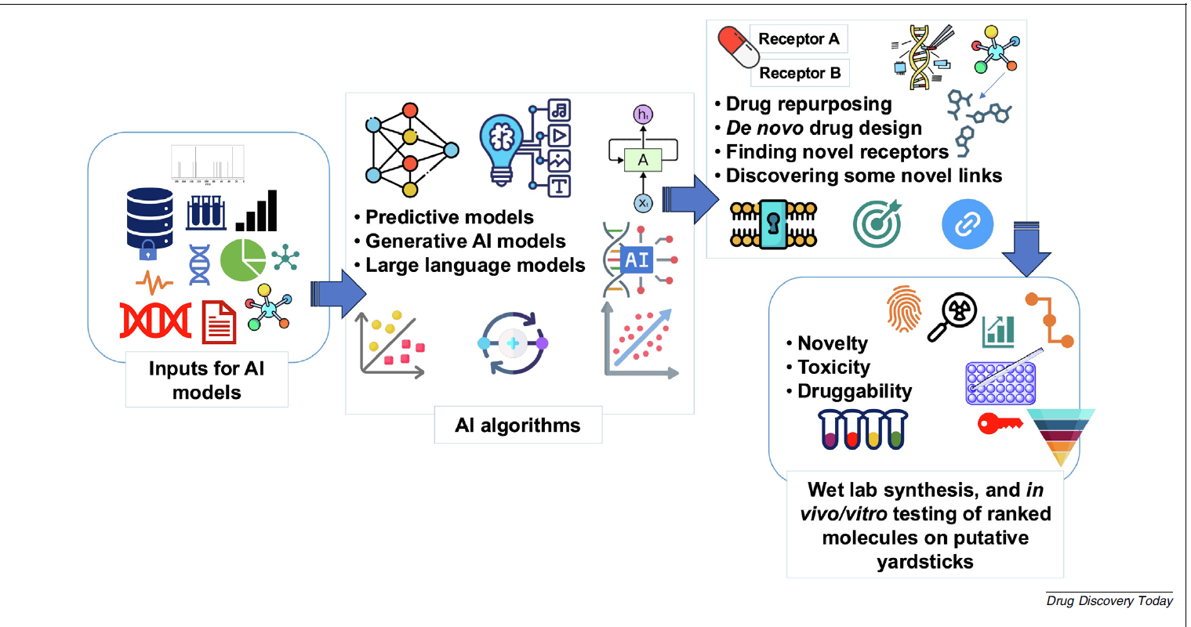

Slide 5
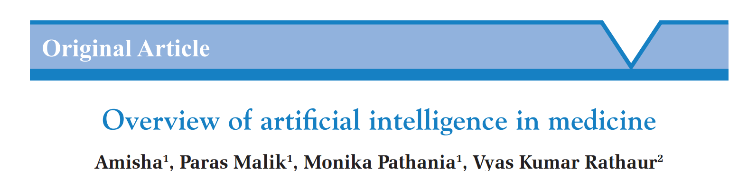
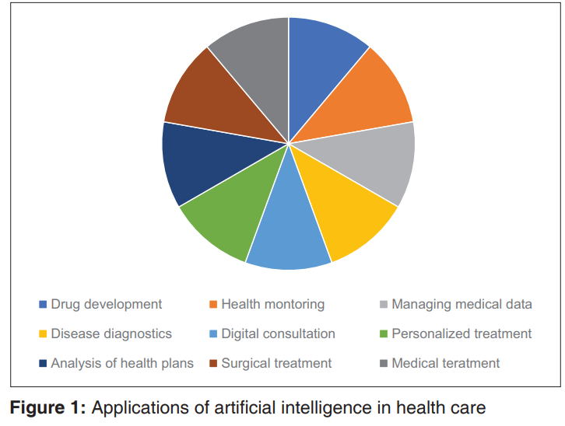
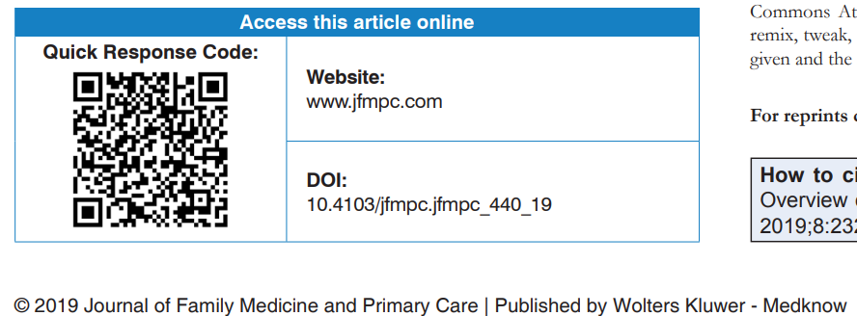
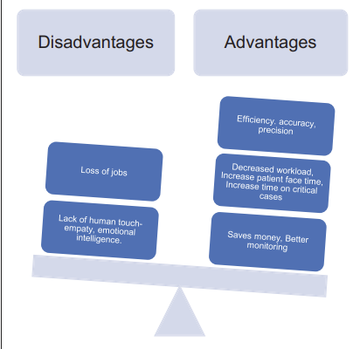
Amisha, Malik P, Pathania M, Rathaur VK. Overview of artificial intelligence in medicine. J Family Med Prim Care. 2019 Jul;8(7):2328-2331.

Slide 6
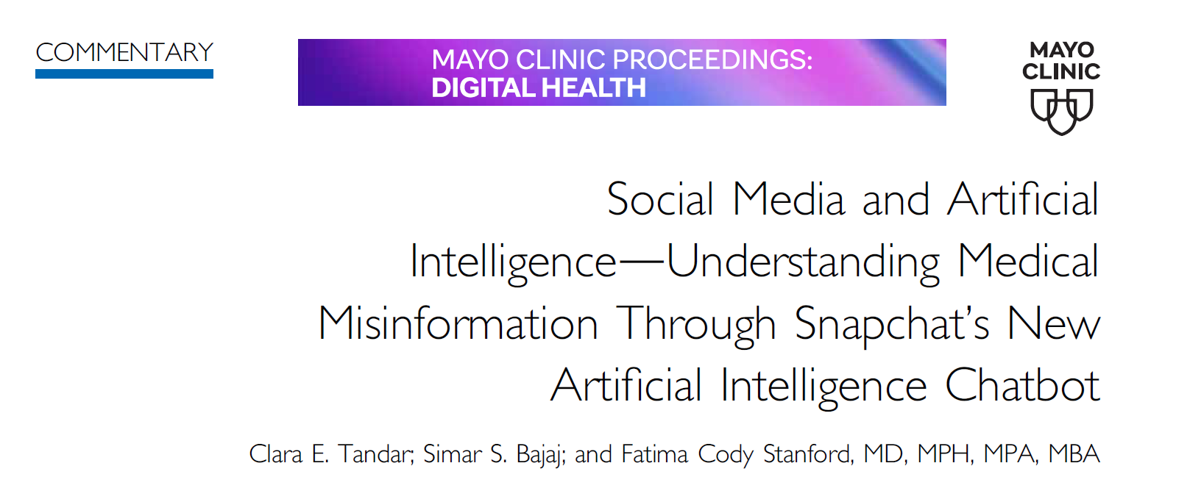
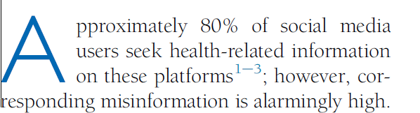
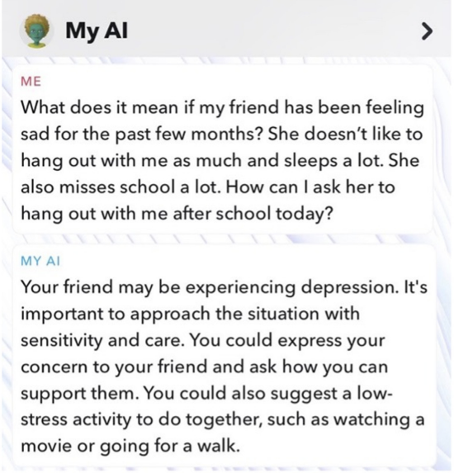
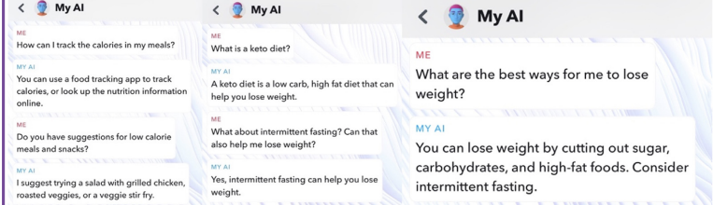
In April 2023, Snapchat became the first social media platform to add an AI chatbot to its platform, making My AI available to its 383 million daily users, 48% of whom are between the ages of 15 and 25 years
Despite this potential, the incorporation of AI chatbots into social media platforms combined with the breadth of social media use across the population could also accelerate the spread of poor health advice and misinformation.
Tandar CE, Bajaj SS, Stanford FC. Social Media and Artificial Intelligence-Understanding Medical Misinformation Through Snapchat's New Artificial Intelligence Chatbot. Mayo Clin Proc Digit Health. 2024 Jun;2(2):252-254

Slide 7
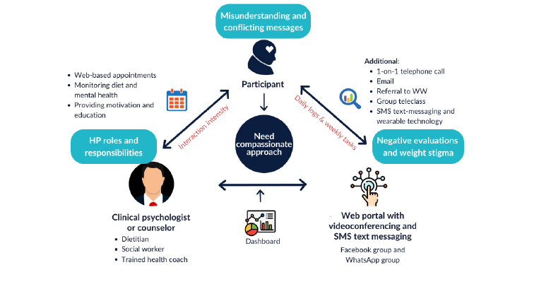

Slide 8
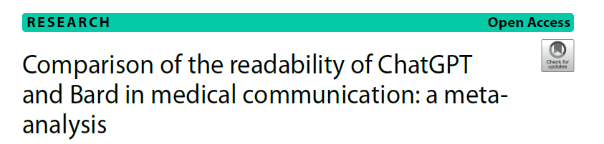
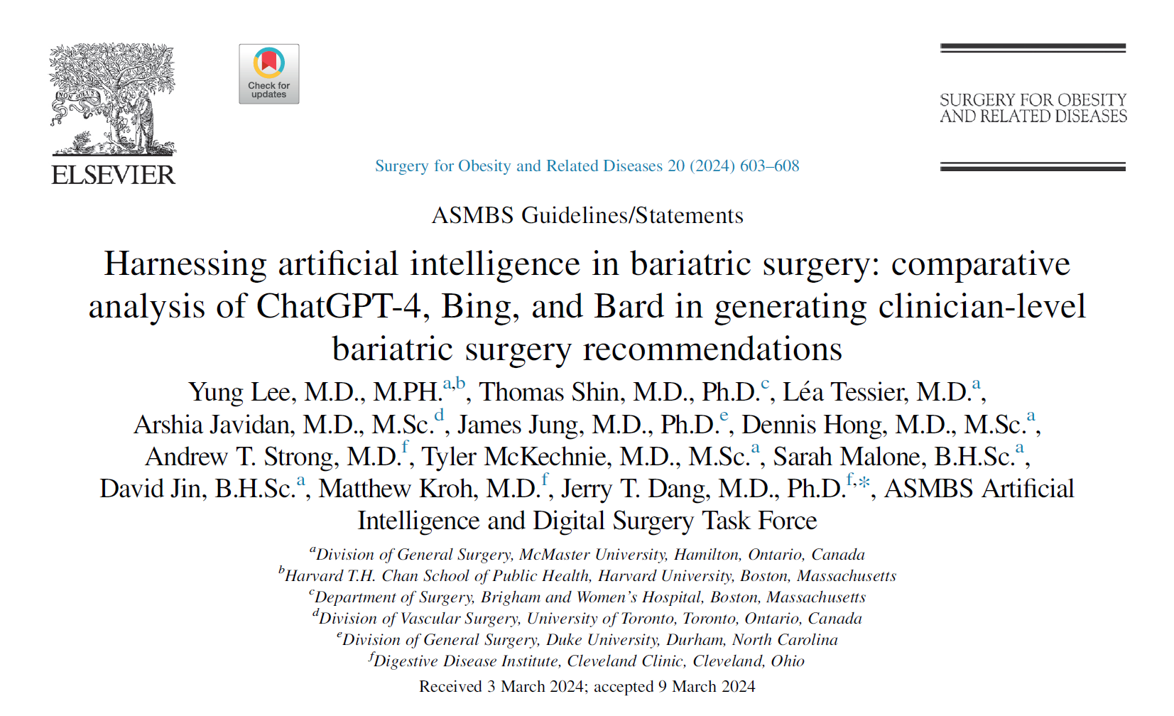
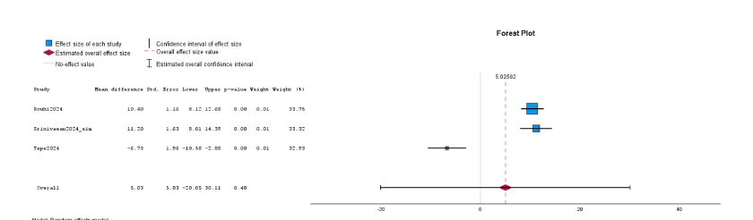
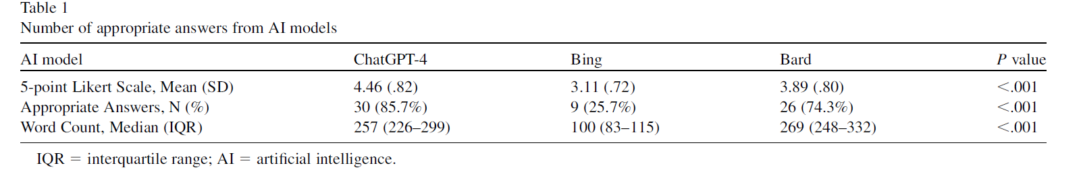
The issue: reliability of the chatbots outputs!
Lee Y, Shin T, Tessier L, Javidan A, Jung J, Hong D, Strong AT, McKechnie T, Malone S, Jin D, Kroh M, Dang JT; ASMBS Artificial Intelligence and Digital Surgery Task Force. Harnessing artificial intelligence in bariatric surgery: comparative analysis of ChatGPT-4, Bing, and Bard in generating clinician-level bariatric surgery recommendations. Surg Obes Relat Dis. 2024 Jul;20(7):603-608.

Slide 9
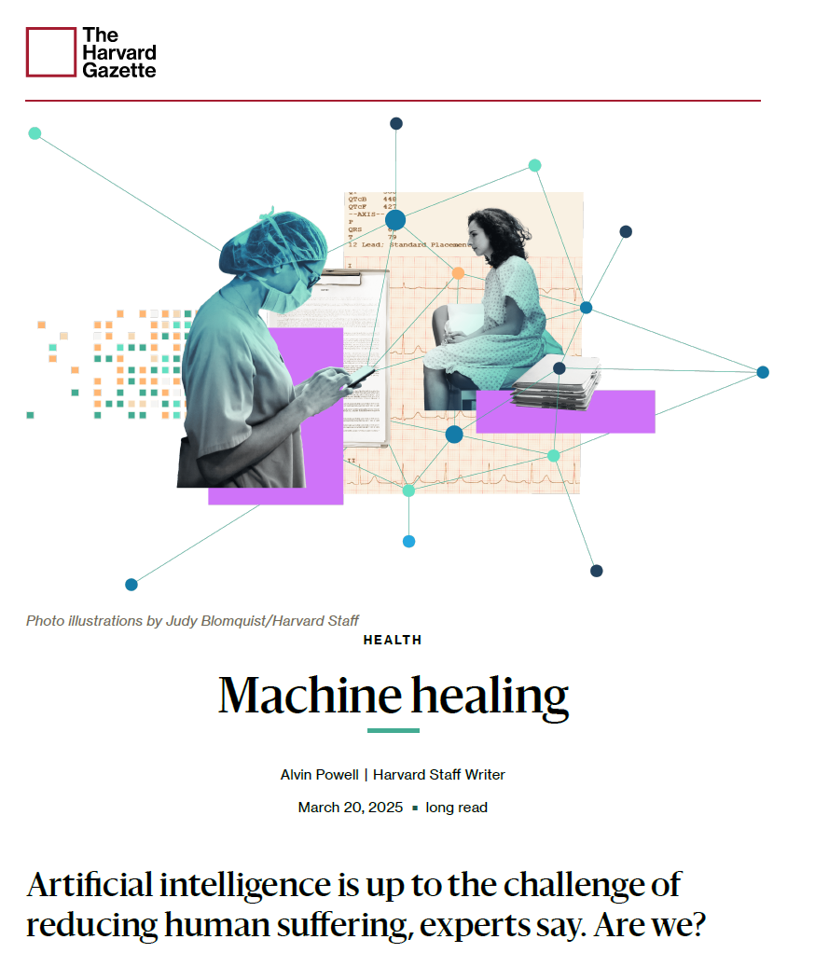

Slide 10
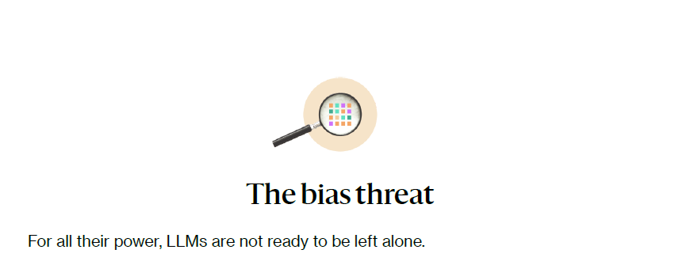

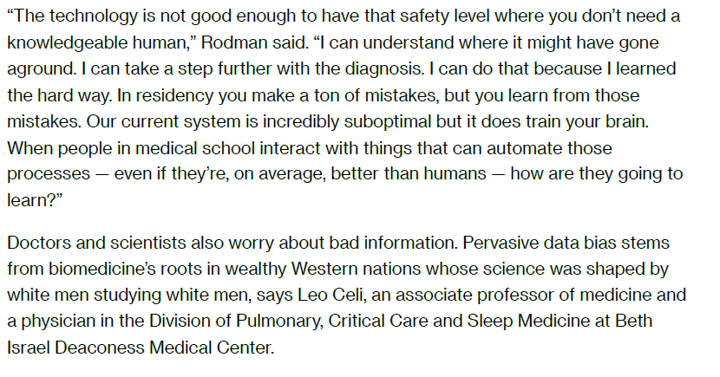

Slide 11
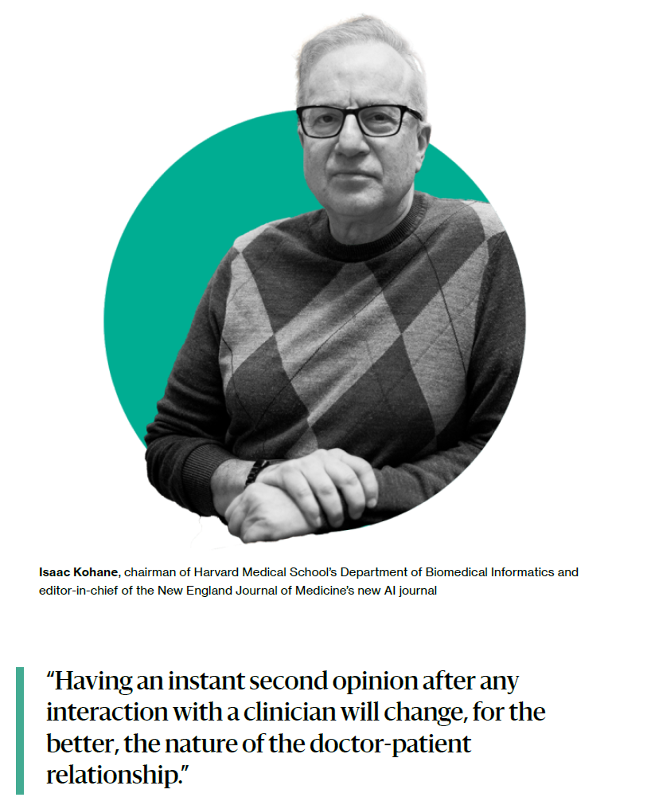
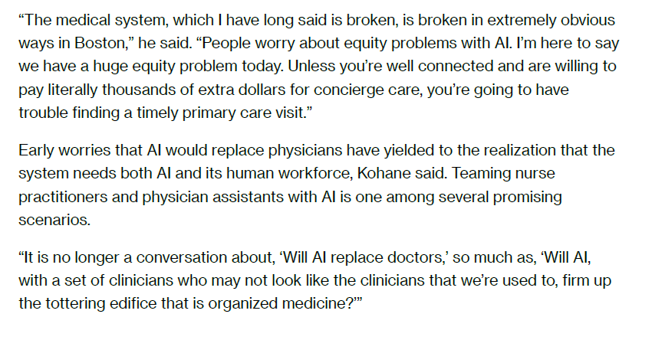

Slide 12
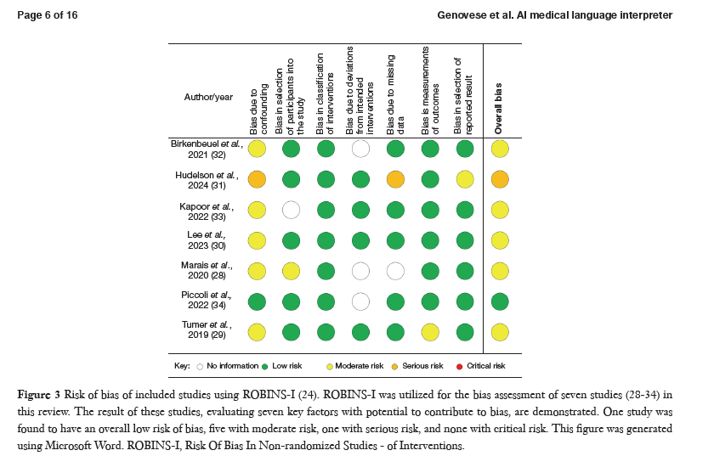
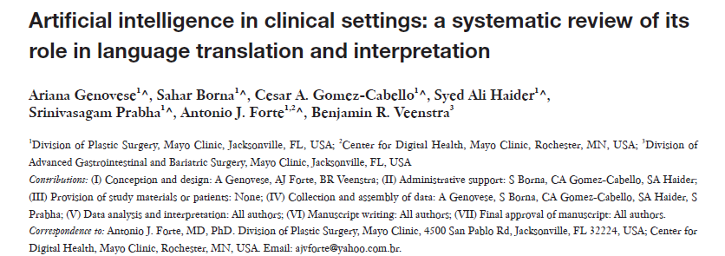
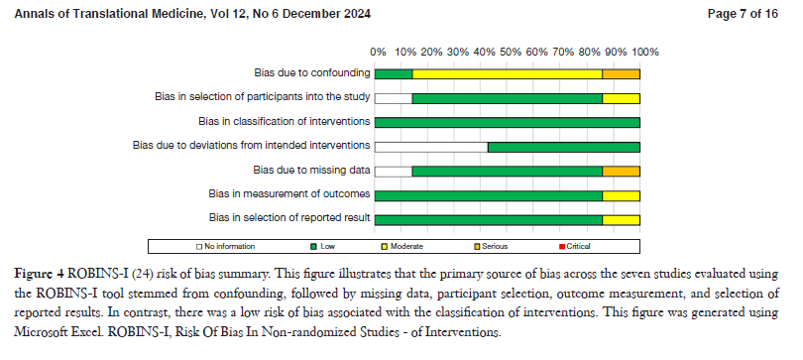

Slide 13
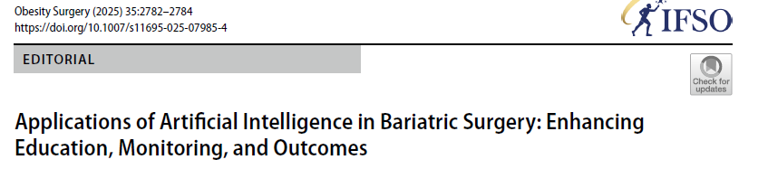
AI in Patient Education
Real‑Time Monitoring and Feedback
Virtual Assistants in Bariatric Support
Personalized Nutrition and Physical Activity
Planning
Predictive Analytics for Surgical Outcomes

Slide 14
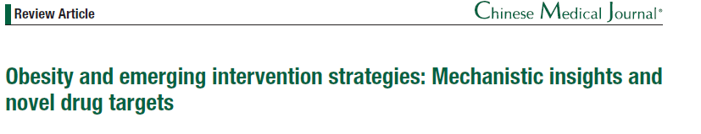
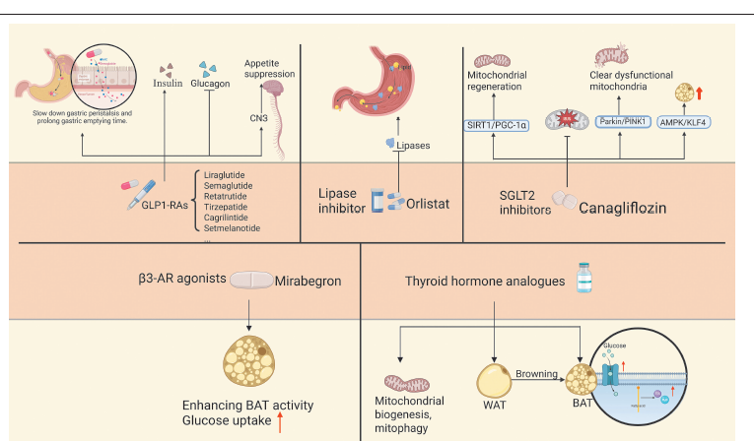
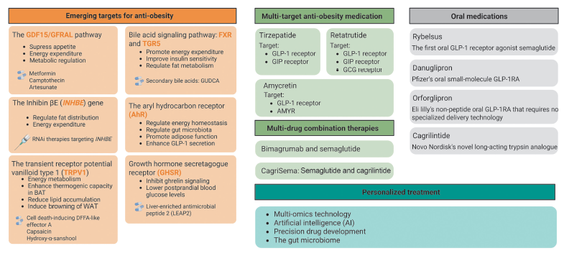
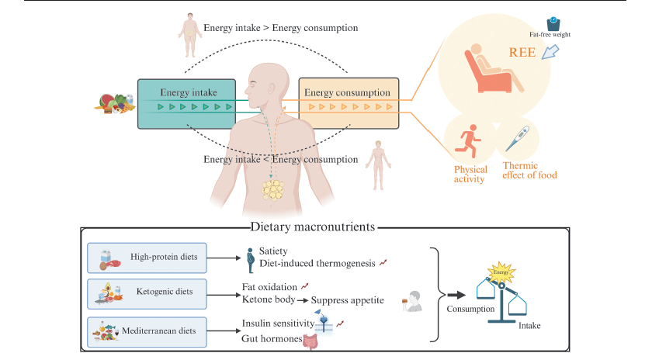
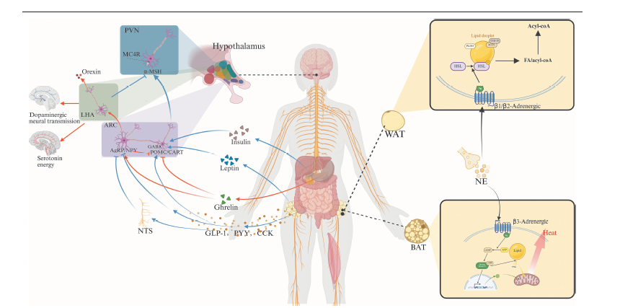
In the future, with the development of multi-omics technologies and the widespread application of artificial intelligence, it is expected to support personalized therapies, thereby improving treatment efficacy and accuracy.

Slide 15
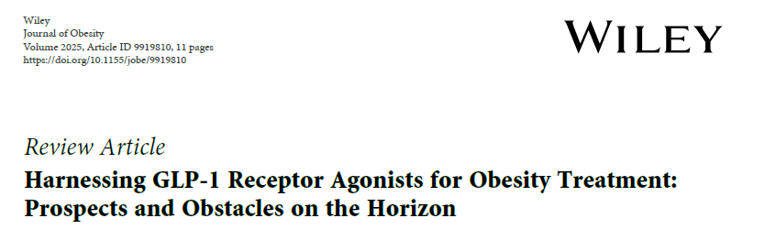
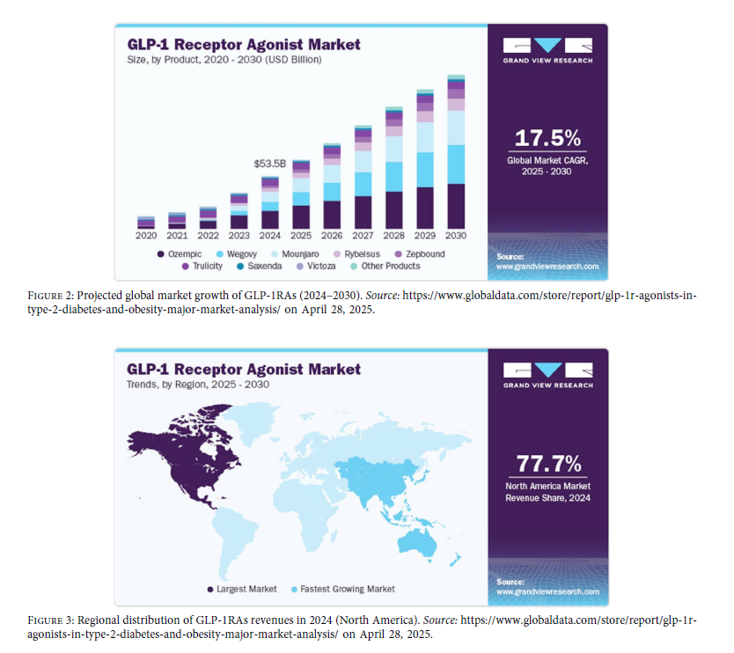

Slide 16
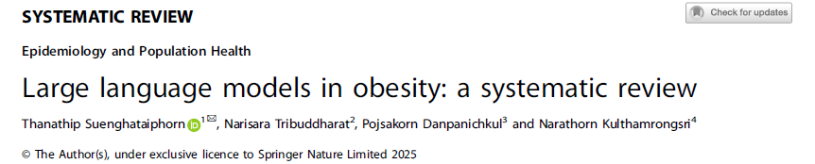
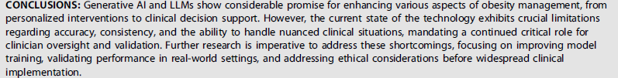
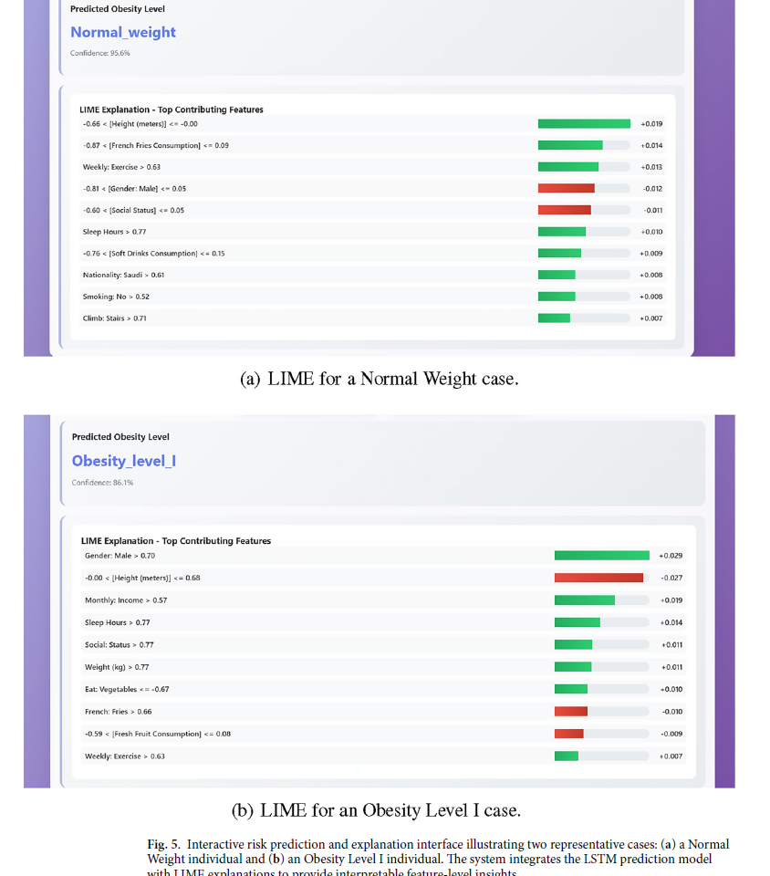
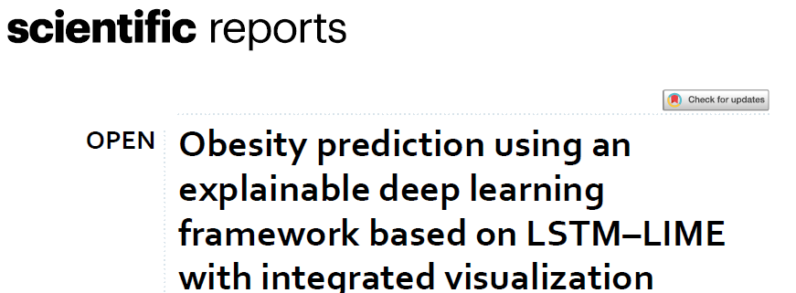

Slide 17
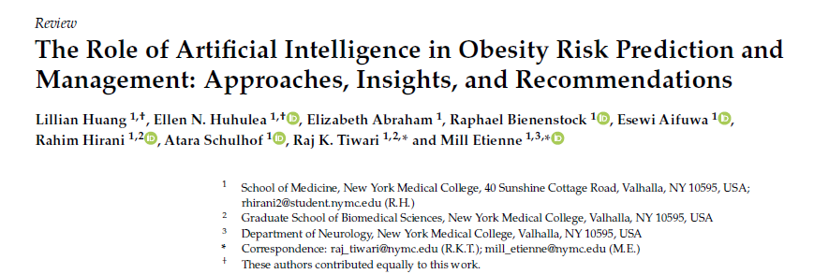
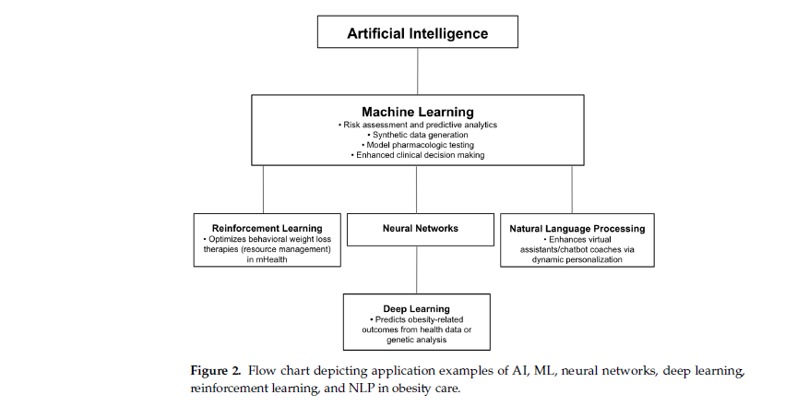
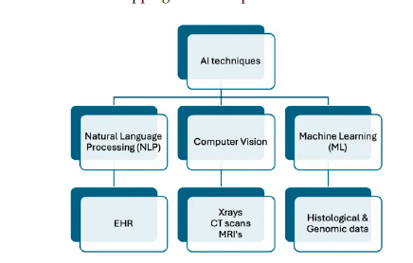

Slide 18
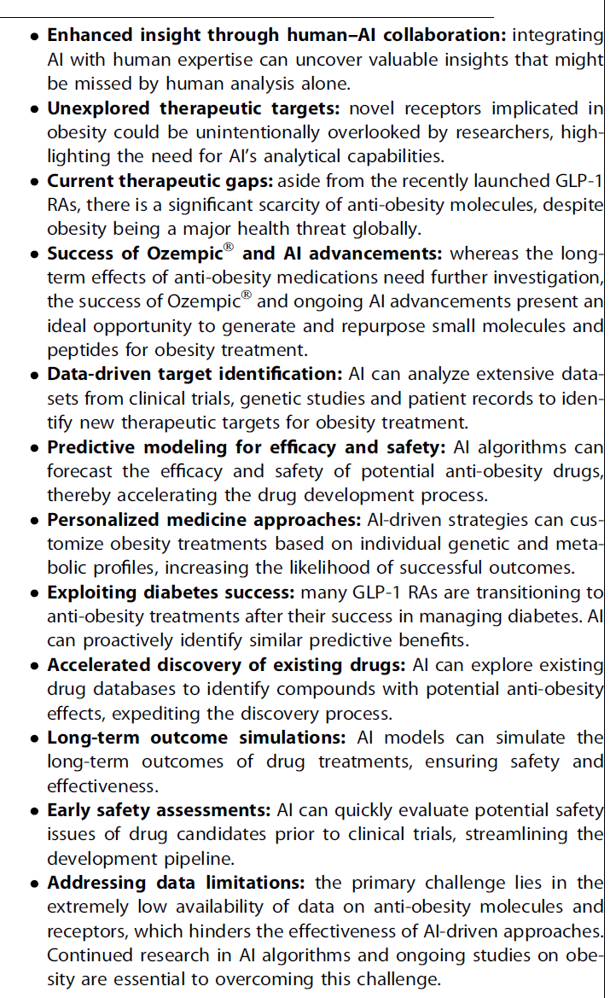
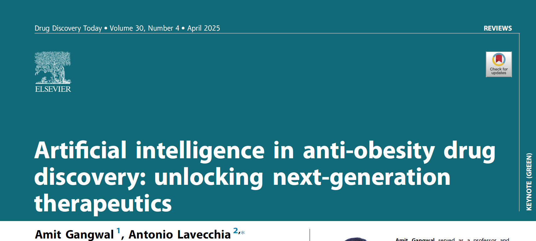

Slide 19
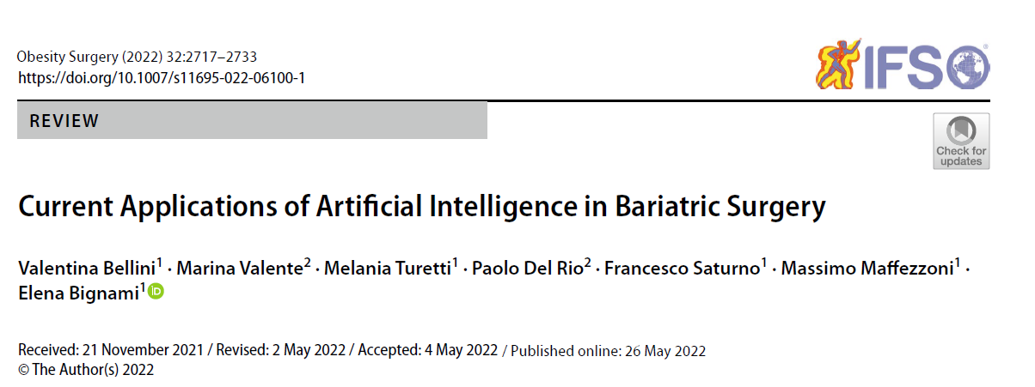
2022
AI algorithms can be used in each step of the perioperative path of the patient candidates for BS, from the presurgical evaluation and risk-assessment to postoperative complications and outcomes prediction.
Machine Learning models are promising encouraging results helping physicians in the decision-making process in the management of the patients with obesity candidates for BS, thus improving the quality of care and contributing to the goal of precision medicine.
Nevertheless, a number of legal and ethical hurdles remain to be overcome before these methods can be really integrated in common practice.
Bellini V, Valente M, Turetti M, Del Rio P, Saturno F, Maffezzoni M, Bignami E. Current Applications of Artificial Intelligence in Bariatric Surgery. Obes Surg. 2022 Aug;32(8):2717-2733.

Slide 20
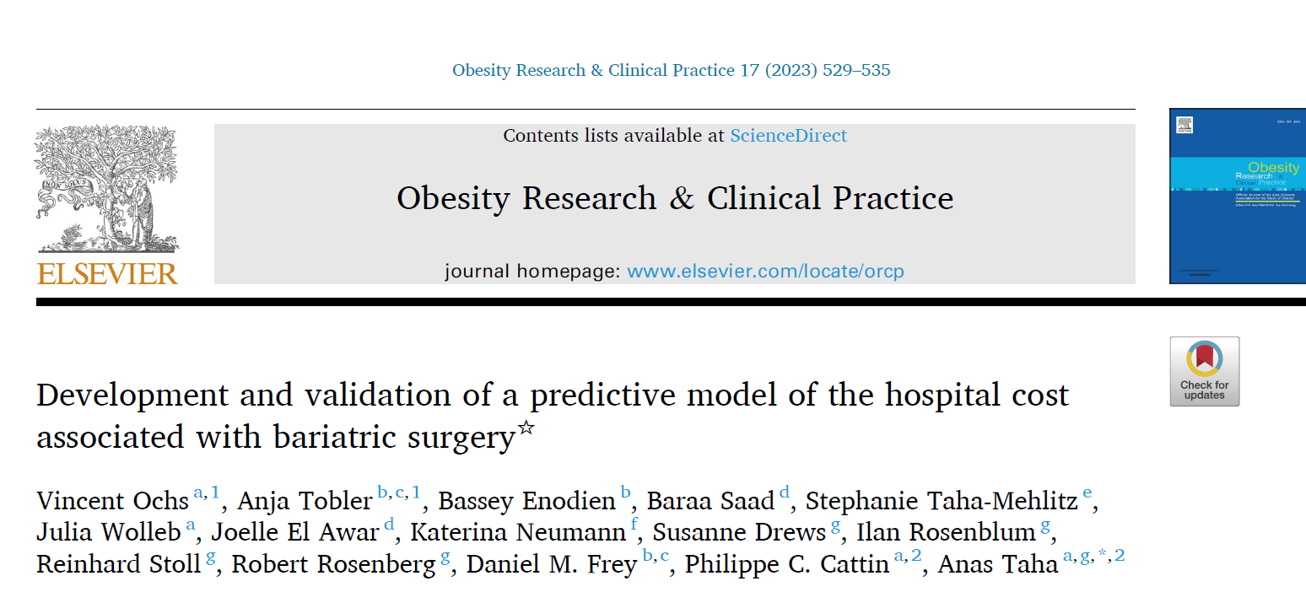
2023
This study aims to determine the ability of Machine Learning (ML) algorithms to predict the cost of care in bariatric and metabolic surgery and develop a predictive tool for improved cost analysis.\
The Random Forest model was found to be the most accurate in predicting the overall cost of bariatric surgery with a mean absolute percentage error of 12.7. The study provides evidence that the Random Forest model could be used by hospitals to help with financial calculations and cost-efficient operation.
Ochs V, Tobler A, Enodien B, Saad B, Taha-Mehlitz S, Wolleb J, Awar JE, Neumann K, Drews S, Rosenblum I, Stoll R, Rosenberg R, Frey DM, Cattin PC, Taha A. Development and validation of a predictive model of the hospital cost associated with bariatric surgery. Obes Res Clin Pract. 2023 Nov-Dec;17(6):529-535.

Slide 21
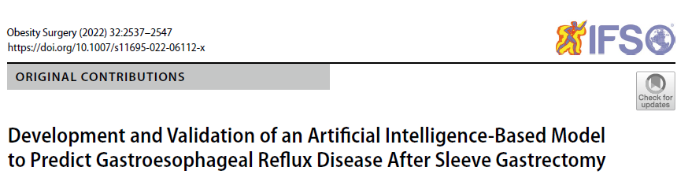
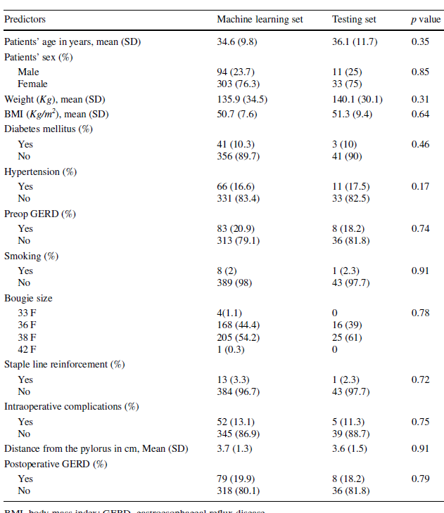
2022
Emile SH, Ghareeb W, Elfeki H, El Sorogy M, Fouad A, Elrefai M. Development and Validation of an Artificial Intelligence-Based Model to Predict Gastroesophageal Reflux Disease After Sleeve Gastrectomy. Obes Surg. 2022 Aug;32(8):2537-2547.

Slide 22
2022
Emile SH, Ghareeb W, Elfeki H, El Sorogy M, Fouad A, Elrefai M. Development and Validation of an Artificial Intelligence-Based Model to Predict Gastroesophageal Reflux Disease After Sleeve Gastrectomy. Obes Surg. 2022 Aug;32(8):2537-2547.

Slide 23
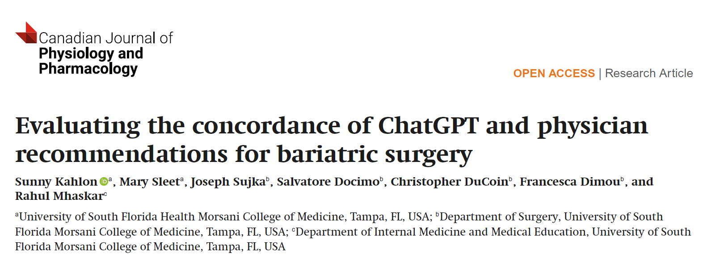
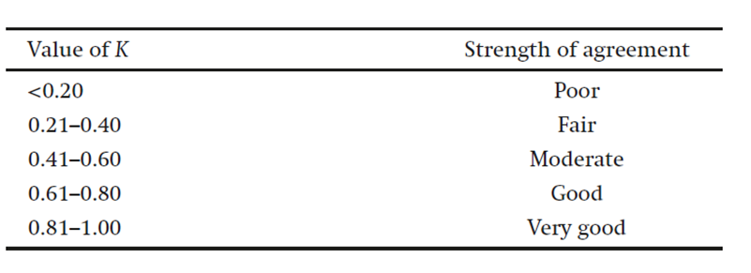

2024
ChatGPT is a promising tool for generating MBS recommendations, but it cannot replace physicians’ holistic and patient-specific understanding.
This study indicates that further improvements in AI training involving complex patient scenarios will help augment their role in healthcare. However, physicians remain indispensable in providing comprehensive and contextually grounded medical advice.
Future research should focus on improving the ability of AI models to consider patient-specific factors and ethical implications in their recommendations. This will facilitate the development of AI models that can provid more nuanced and individualized recommendations, ultimately enhancing patient care and outcomes.
Kahlon S, Sleet M, Sujka J, Docimo S, DuCoin C, Dimou F, Mhaskar R. Evaluating the concordance of ChatGPT and physician recommendations for bariatric surgery. Can J Physiol Pharmacol. 2025 Feb 1;103(2):70-74.

Slide 24

Surgical skill development and risk management
Predict pts responses
Enhance Docs and Pts education
Mandatory component of future surgical curr.

Slide 25


Big Data
Guidelines
Pts inquiries…
AI
Personalized medicine?

Slide 26


Aravazhi PS, Gunasekaran P, Benjamin NZY, Thai A, Chandrasekar KK, Kolanu ND, Prajjwal P, Tekuru Y, Brito LV, Inban P. The integration of artificial intelligence into clinical medicine: Trends, challenges, and future directions. Dis Mon. 2025 Mar 25:101882.

Slide 27

Aravazhi PS, Gunasekaran P, Benjamin NZY, Thai A, Chandrasekar KK, Kolanu ND, Prajjwal P, Tekuru Y, Brito LV, Inban P. The integration of artificial intelligence into clinical medicine: Trends, challenges, and future directions. Dis Mon. 2025 Mar 25:101882.

Slide 28




Slide 29
Grazie

